Slide 1
Robots that Learn Grounded Language Through Interactive Dialog
Raymond J. Mooney
University of Texas at Austin
Joint Work with:
Jesse Thomason, Aishwarya Padmakumar, Jivko Sinapov, Peter Stone, Shiqi Zhang, Justin Hart, Maxwell Svetlik
1
1
Notes:
1
1

Slide 2
Learning from Interactive Dialog
Most NLP systems, including robotic ones, require large amounts of pre-assembled manually labeled training data.
This is laborious and may not capture the knowledge needed during actual end use.
Ideally, a robot could learn to understand language better through natural interaction with human users while in operation.

Slide 3
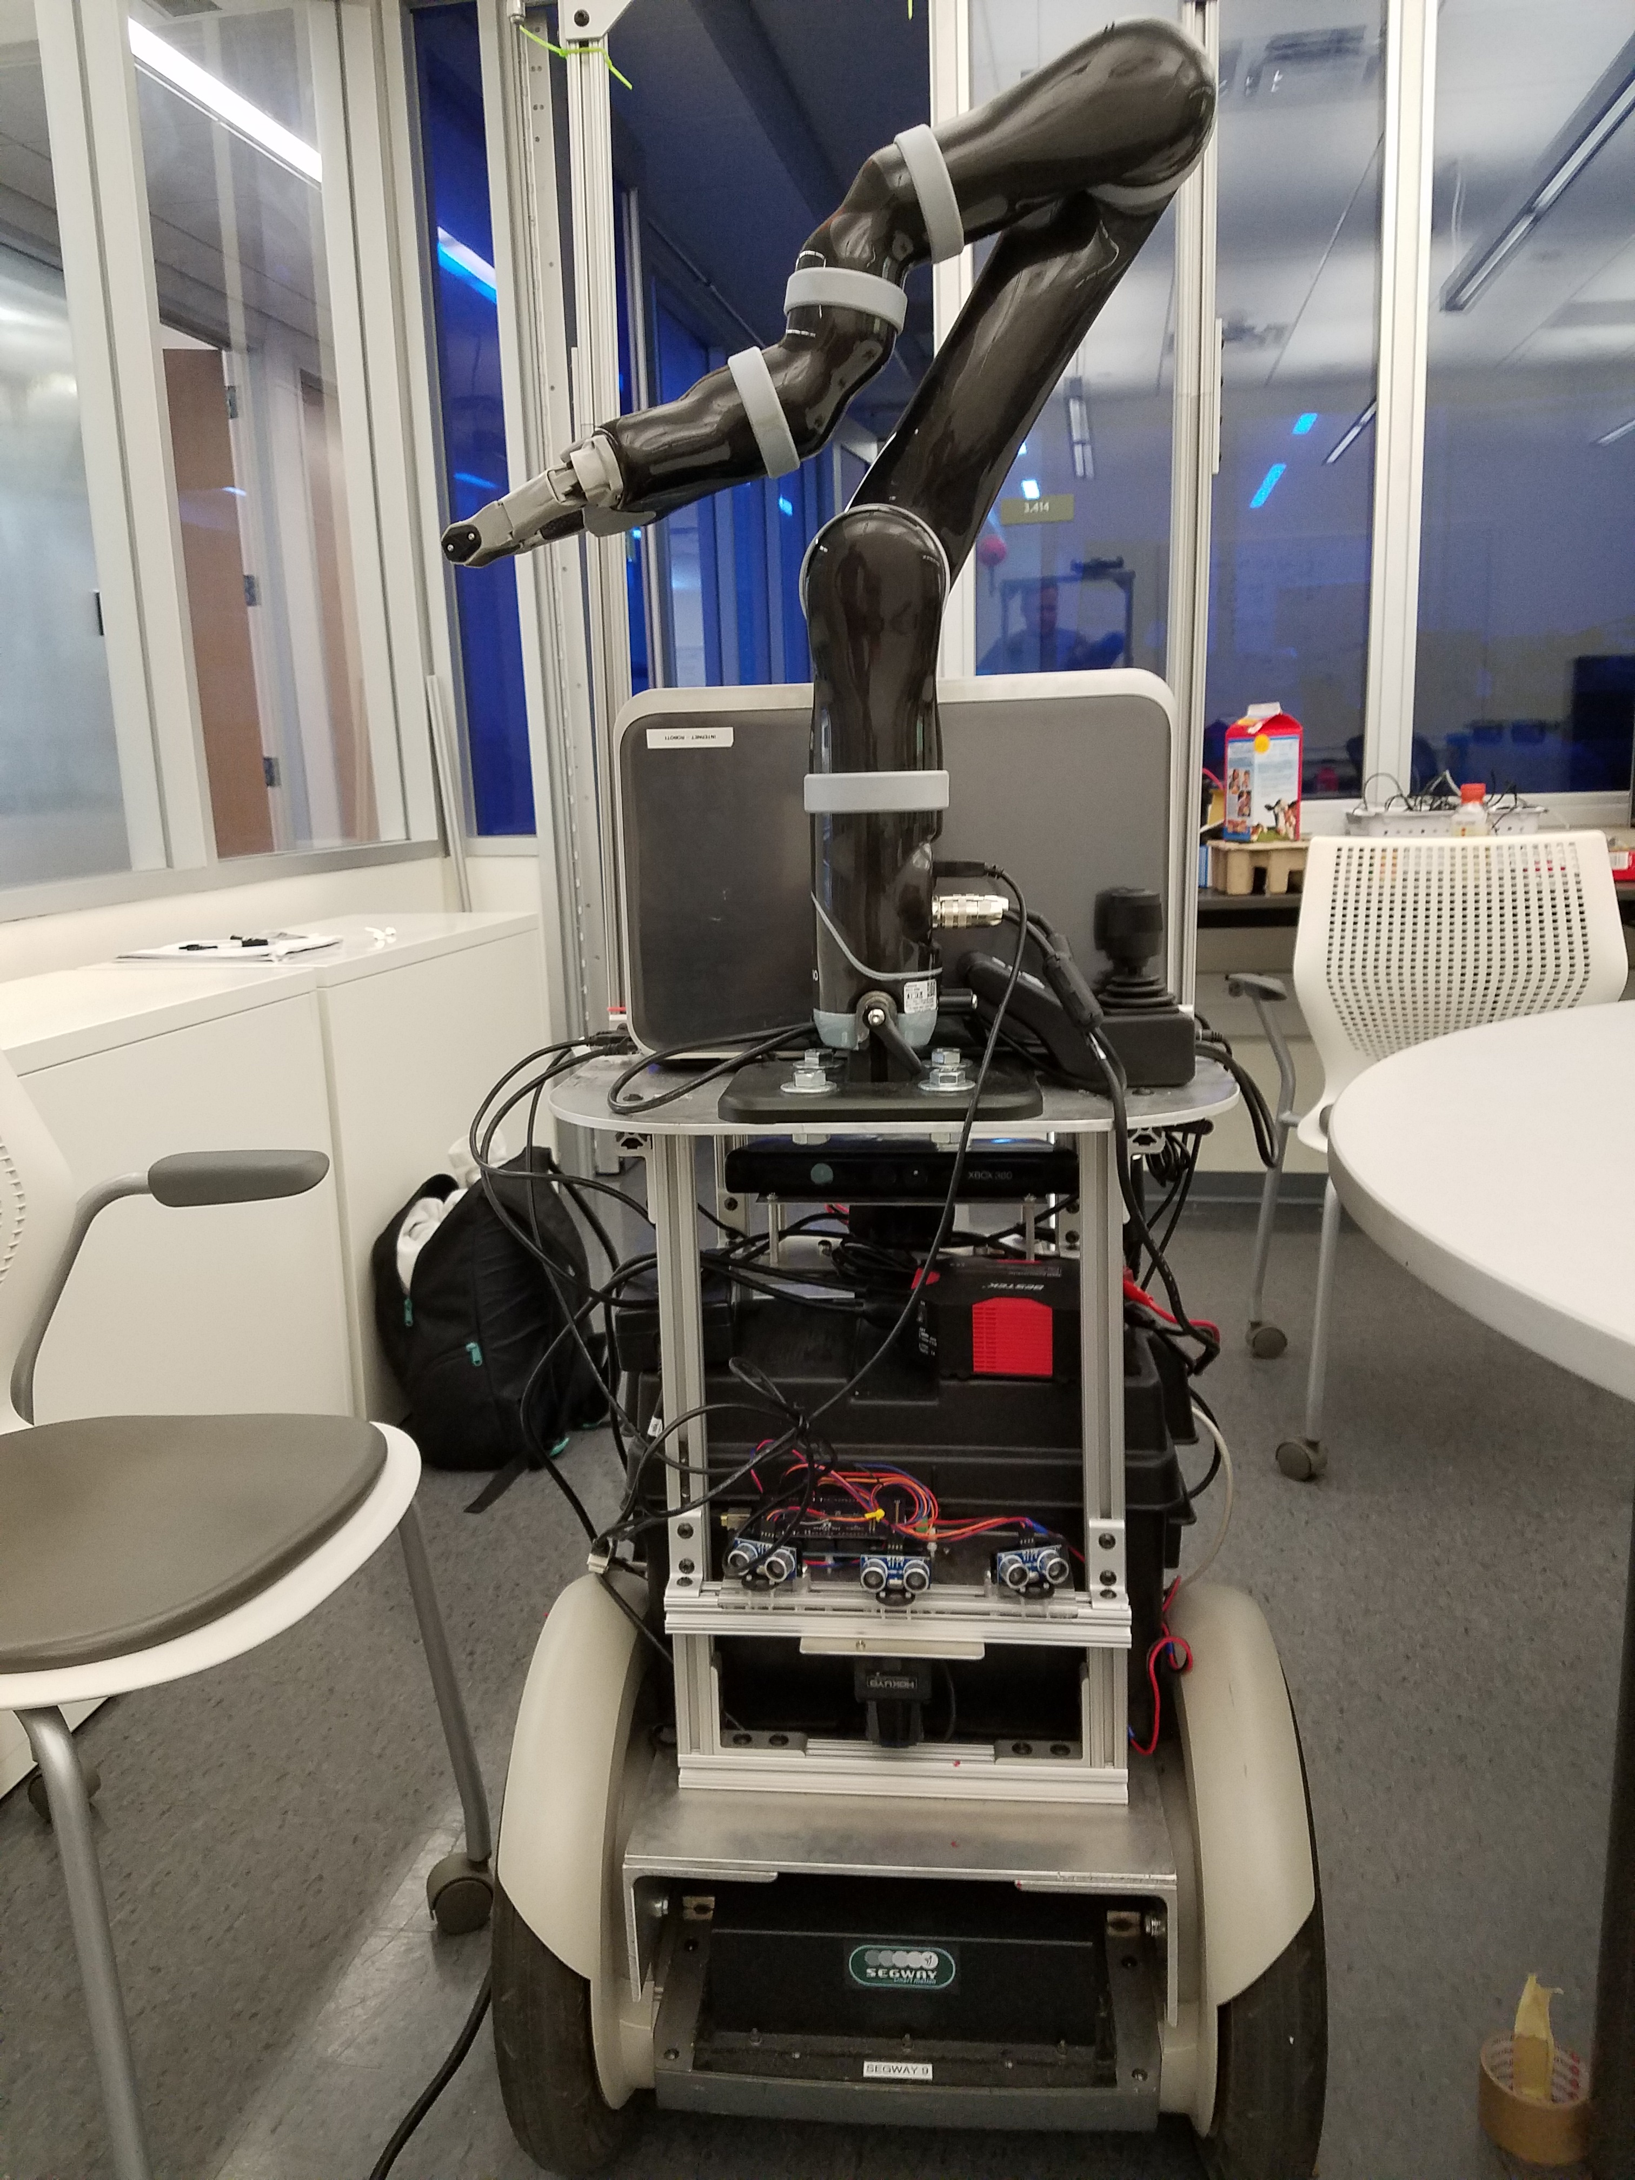

Natural Language Understanding for Robots
Go to Alice’s office and get the light mug for the chair.

Slide 4
Natural Language Understanding for Robots
Go to Alice’s office and get the light mug for the chair.
Commands that need to be actualized through robot action

Slide 5
Natural Language Understanding for Robots
Go to Alice’s office and get the light mug for the chair.
Commands that need to be actualized through robot action
World knowledge about people and the surrounding office space

Slide 6
Natural Language Understanding for Robots
Go to Alice’s office and get the light mug for the chair.
Commands that need to be actualized through robot action
World knowledge about people and the surrounding office space
Perception information to identify referent object
Notes:
Remember that “Alice’s office” is world knowledge but that a space being an “office” can be considered perceptual

Slide 7
Learning to Interpret Natural Language Commands through Human-Robot Dialog
Commanding Robots
Dialog
Thomason et al., IJCAI-2015
Semantic Parsing

Slide 8
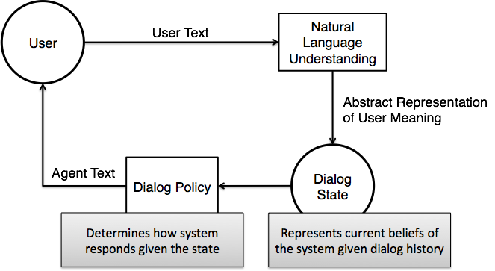
Dialog

Slide 9
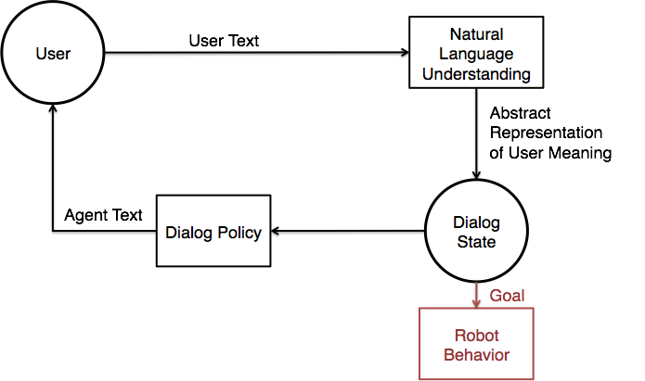
Commanding Robots
Dialog can be used for commanding robots [Matuszek, 2012; Mohan, 2012]

Slide 10
Background: Semantic Parsing
Go to Alice’s office and get the light mug for the chair.
Training Data
Semantic Parser
go(the(λx.(office(x) ⋀ owns(alice, x)))) ⋀ deliver(the(λy.(light(y) ⋀ mug(y))), bob)
Notes:
Remember to say out loud that “bob” is “the chair”

Slide 11
Generating New Training Examples from Dialog
Past work generates training data for a semantic parser given a corpus of conversations [Artzi & Zettlemoyer, 2011]
We pair a confirmed understanding from a dialog with previous misunderstood utterances.
When system finally understands some meaning Y, assume all past utterances X_{i} that tried to refer to Y mean Y

Slide 12
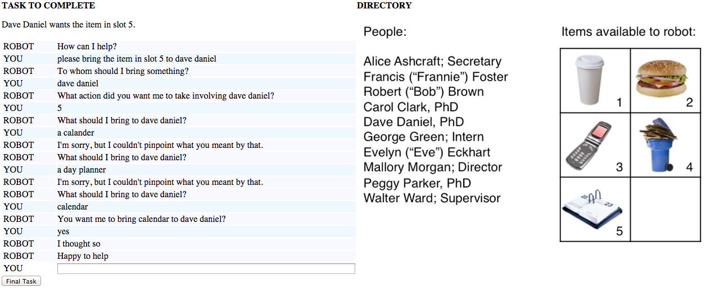

Slide 13
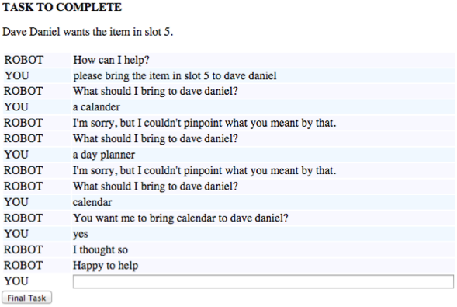

Generating New Training Examples
Notes:
Step through this somewhat slowly since we don’t foreshadow it

Slide 14

Generating New Training Examples

Slide 15

Generating New Training Examples

Slide 16
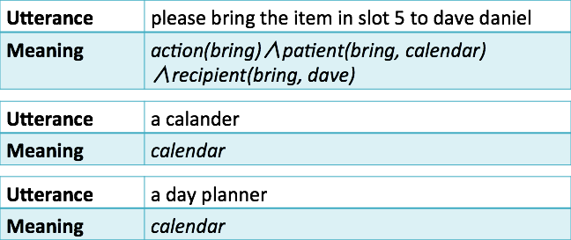
Generating New Training Examples

Slide 17
Experiments
Hypothesis: Performing incremental re-training of a parser with sentence/parse pairs obtained through dialog will result in better user experience than using a pre-trained parser alone
Tested via:
Mechanical Turk - many users, less realistic interaction (just text, no robot)
Segbot Platform - few users, natural interactions with real world robot

Slide 18
Mechanical Turk Experiment
Four training batches of ~100 users each
Retraining after every batch (~50 training goals)
Performance measured after every batch (~50 testing goals)
Goals:
Navigation - user told the robot is needed in a certain room (one action, single argument)
Delivery - user told a certain person needs a certain item (one action, two arguments)

Slide 19
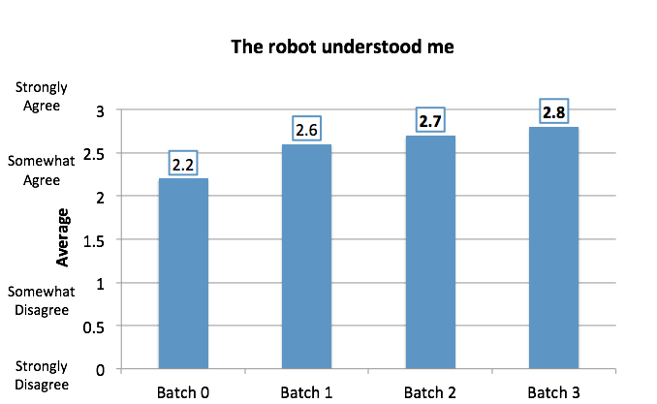
Mechanical Turk Survey Responses

Slide 20
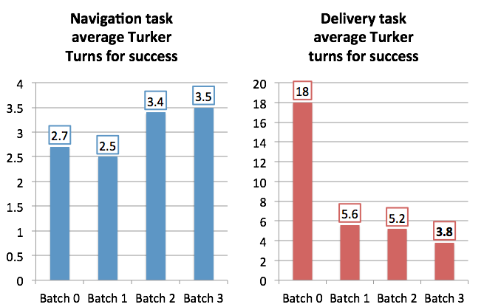
Mechanical Turk Dialog Turns

Slide 21
Segbot Experiment
10 users with baseline system (no additional training)
Robot roamed the office for four days
34 conversations with users in the office ended with training goals
System re-trained after four days
Final Test: 10 users with re-trained system

Slide 22
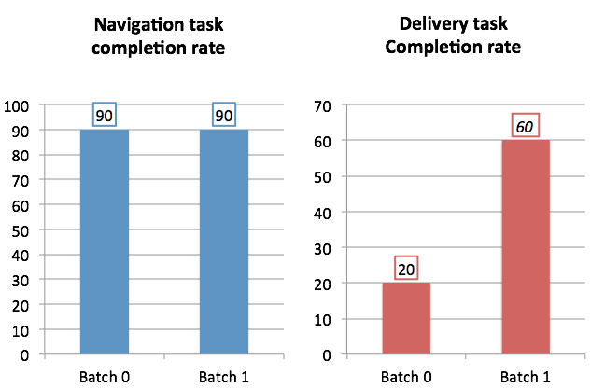
Segbot Dialog Success

Slide 23
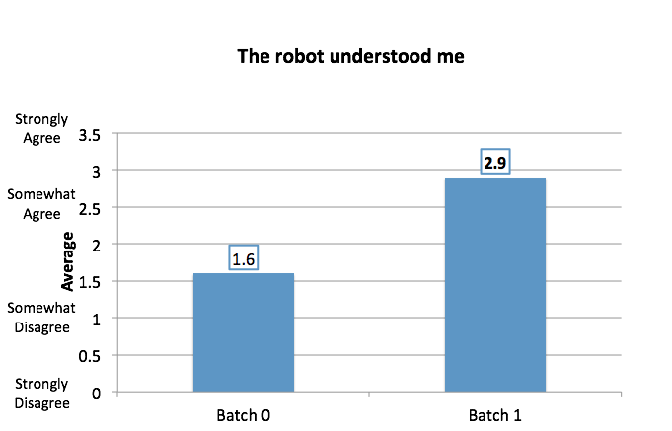
Segbot Survey Responses

Slide 24
Integrated Learning of Dialog Strategies and Semantic Parsing (Padmakumar et al., EACL-2017)
Previous system uses a fixed, hand-coded dialog policy.
There is a long tradition of using Reinforcement Learning to learn better dialog policies from experience.
Can both improved dialog policies and semantic parsers be learned jointly from interactive dialog?
Notes:
Because of this, we need to choose our policy learning algorithm carefully. We use the Kalman Temporal Differences Q Learning algorithm for this, as it allows us to effectively learn a policy in a non-stationary environment, from dialogs collected offline. This allows us to obtain training dialogs in batches via crowdsourcing

Slide 25
Background: RL and POMDPs
Reinforcement learning - learning for sequential tasks with only implicit feedback
Partially Observable Markov Decision Process -
Agent
(b_{t-1})
Agent
(b_{t})
a_{t}
o_{t}
Environment
(s_{t})
Environment
(s_{t})
Environment
(s_{t+1})
Notes:
Just like with the parser, we would like our policy also to adapt continuously based on interactions with users. For this, we turn to Reinforcement Learning. Specifically, the model we use is called a Partially Observable Markov Decision Process or POMDP. There is an agent interacting with an environment. At time t, the agent is in state s_t, but this is hidden from it. What it receives is a noisy version of s_t, called the observation o_t. Based on observations, the agent maintains a probability distribution over all states it could be in at time t, called the belief b_t. Based on b_t, the agent takes an action a_t, which causes it to transition to state s_{t+1}

Slide 26
Clarification Dialogs as POMDPs
States: What the user is trying to convey via the dialog (commands)
Observations: Output of the natural language understanding component
Actions: Dialog actions (confirming, requesting a parameter value)

Slide 27
Why is policy learning challenging?
Agent
(b_{t-1})
Agent
(b_{t})
Assumption:
a_{t}
o_{t}
Constant probability distribution
Environment
(s_{t})
Environment
(s_{t})
Environment
(s_{t+1})
Agent
(b_{t-1})
Agent
(b_{t})
Our system:
a_{t}
o_{t}
Variable probability distribution
Environment
(s_{t})
Environment
(s_{t})
Environment
(s_{t+1})

Slide 28
Why is policy learning challenging?
Agent
(b_{t-1})
Agent
(b_{t})
Assumption:
a_{t}
o_{t}
Constant probability distribution
Environment
(s_{t})
Environment
(s_{t})
Environment
(s_{t+1})
Non-stationary Environment
Agent
(b_{t-1})
Agent
(b_{t})
Our system:
a_{t}
o_{t}
Variable probability distribution
Environment
(s_{t})
Environment
(s_{t})
Environment
(s_{t+1})

Slide 29
Policy learning
Kalman Temporal Differences (KTD) Q Learning (Geist and Pietquin, 2010) used to learn policy in non-stationary environment
Dialog state tracking - HIS Model (Young et al., 2010)
Policy learned over features extracted from belief state
Notes:
Because of this, we need to choose our policy learning algorithm carefully. We use the Kalman Temporal Differences Q Learning algorithm for this, as it allows us to effectively learn a policy in a non-stationary environment, from dialogs collected offline. This allows us to obtain training dialogs in batches via crowdsourcing

Slide 30
Hypotheses
Combined parser and dialog learning is more useful than either alone.
Changes in the parser need to be seen by the policy learner.

Slide 31
Systems
Parser and Dialog Learning - Full
Initial parser
Update parser
Final parser
Collect Dialogs
Initial policy
Update policy
Final policy
Parser and Dialog Learning - Batchwise
Initial parser
Update parser
Final parser
Collect Dialogs
Collect Dialogs
Initial policy
Update policy
Final policy

Slide 32
Experiments - Metrics
Successful dialog -
User does not exit dialog prematurely
Robot performs the correct action
Objective metrics -
% successful dialogs
Dialog length - Average number of turns in successful dialogs
Subjective metrics -
The robot understood me

Slide 33
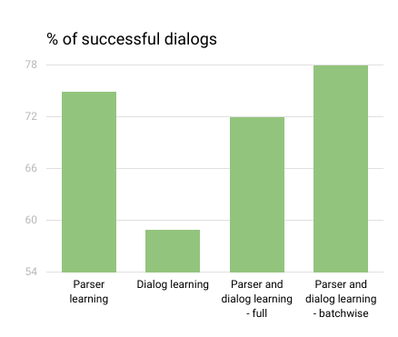
Results - Dialog Success
78
75
Higher is better
Parser learning is mostly responsible for improvement in dialog success rate
Best system: parser and dialog learning - batchwise
72
59
Notes:
We compared 4 systems - only parser learning, only dialog learning and two settings with both parser and dialog learning. The “batchwise” setting is where both components are updated after each batch of dialogs. In the “full” setting, we collect all 4 training batches at once with the initial components and perform one update using all these dialogues before testing. We can see that parse75
r learning contributes much more towards dialog success but dialog policy learning is more effective at reducing the dialog length. We also see that training both components is more useful, if done in a batchwise manner. The poor performance of the “full” setting is indicative of the fact that the effect of a non stationary environment is non-trivial.

Slide 34
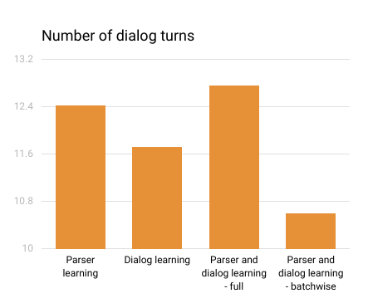
Results - Dialog Length
12.76
Lower is better
Dialog learning is mostly responsible for lowering dialog length
Best system: parser and dialog learning - batchwise
12.43
11.73
10.61
Notes:
We compared 4 systems - only parser learning, only dialog learning and two settings with both parser and dialog learning. The “batchwise” setting is where both components are updated after each batch of dialogs. In the “full” setting, we collect all 4 training batches at once with the initial components and perform one update using all these dialogues before testing. We can see that parse75
r learning contributes much more towards dialog success but dialog policy learning is more effective at reducing the dialog length. We also see that training both components is more useful, if done in a batchwise manner. The poor performance of the “full” setting is indicative of the fact that the effect of a non stationary environment is non-trivial.

Slide 35
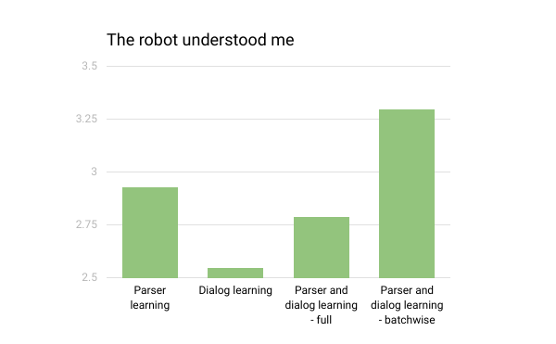
Results - user survey responses
Higher is better
Best system: parser and dialog learning - batchwise
3.30
2.93
2.79
2.55
Notes:
Survey responses were on a 0-4 Likert scale. Again we see that performing both parser and dialog policy learning results in better scores, but the “full” system is not always better than the “batchwise” system.

Slide 36
Learning Multi-Modal Grounded Linguistic Semantics by Playing “I Spy”
Multi-modal Perception
Grounding
Thomason et al., IJCAI-2016
Human-robot Interaction

Slide 37
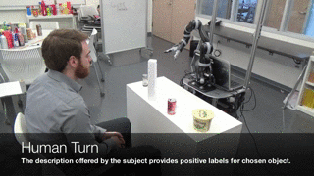
“An empty metallic aluminum container”

Slide 38
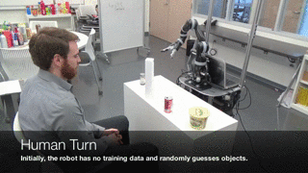
Robot makes guesses until human confirms it found the right object.

Slide 39
Perceptual Language Grounding
Mapping from expressions like “light mug” to an object in the real world is fundamental part of the symbol grounding problem [Harnad, 1990]
Growing body of work connecting language to machine vision [Roy, 2002; Matuszek, 2012; Krishnamurthy, 2013; Christie, 2016]
Some work connecting language to other perceptual modalities, such as audio [Kiela, 2015]

Slide 40
Multi-Modal Perceptual Grounding
For every object, we perform a set of exploratory behaviors with the robotic arm (e.g. lift, push, drop, shake) [Sinapov, 2016]
Gather audio signal from microphone and, proprioceptive and haptic information from arm motors.
Produce a multi-modal feature vector for each object and train classifiers to recognize descriptive words/phrases such as “empty,” “metallic,” etc.

Slide 41
Human-robot Interaction
Use “I Spy” game framework to collect labelled training data.
Allows fun, interactive way for humans to effectively train a robot to ground language in multi-modal perception.

Slide 42
Experiments
32 objects split into 4 folds of 8 objects each
Games played with 4 objects at a time
Two systems: vision only and multi-modal
Each participant played 4 games, 2 with each system (single blind), such that each system saw all 8 objects of the fold
Measure game performance; classifiers always seeing novel objects during evaluations

Slide 43
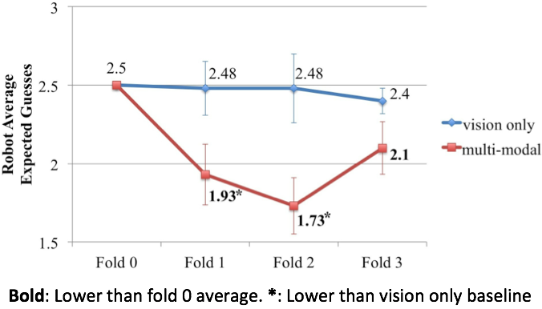
Results for Robot Guesses

Slide 44
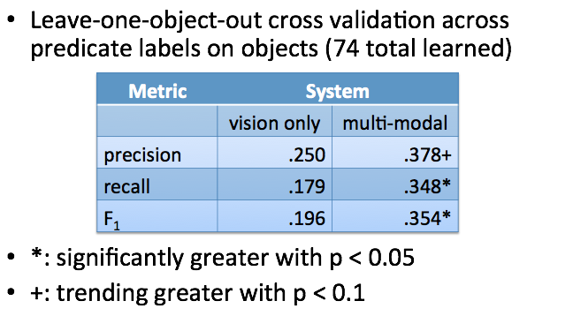
Results for Predicate Agreement

Slide 45
Other/Future Directions
Handle polysemy and synonymy in language grounding by learning multi-modal synsets (Thomason et al., IJCAI-2017).
Allow robot to ask questions about which behaviors that would help ground a particular word/phrase (Thomason et al., RoboNLP-2017).
Grounding semantic parses in both knowledge and perception
Fully integrate learning of semantic parsing, dialog, and grounding in a complete robotic system and evaluate by training and testing with dialogs with end users on real-world tasks.

Slide 46
Conclusions
Robots that learn language from dialogs with end users.
Integrated learning of both semantic parsers and dialog strategies from natural dialogs.
Multi-modal language grounding using a fun, interactive game with users.

